Slide 1


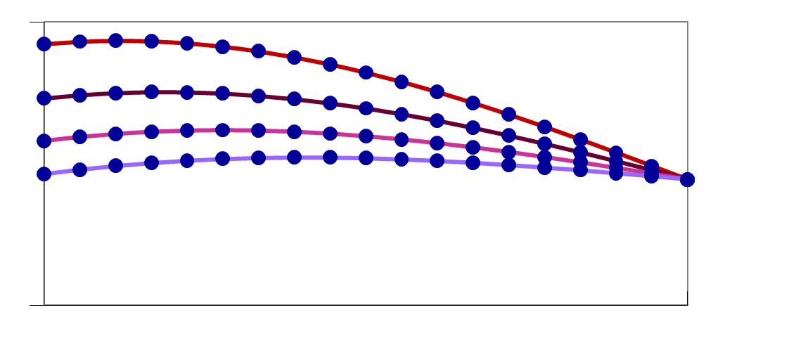
Testing Code
Test all functions
by calling STM code for test problems
STM
Code
Pass
Code Testing
Fail
All functions are tested for a wide range of
conditions and compared to analytical solutions
Individual testing
4.5
Analytical
Spreads
over time
Combination testing
Diffusion
Concentration
Concentration
Advection & Diffusion
0.0
Model (dots) match solution through time (lines)
Moves and spreads
0.1
1.0
Concentration
Advection, Diffusion & Reaction
Distance
Distance
Moves, spreads and
decays
Advection
Uniform Flow
Moves without
spreading
Tidal Flow
Back-n-Forth
No spreading
Concentration
Concentration
Distance
Concentration
Advection & Reaction
Distance
Distance
Moves and decays
Distance
Reaction
Legend
Linear Decay
Concentration
Initial Time
Concentration
Later Time
Distance
Distance
Bay Delta Science Conference, September 2010

